Slide 1
Tableau interactive dashboard
Dashboard for business stake holders

Slide 2
Before dashboard show clear visuals of our analysis
First visual our parameters like total sales, total profit, profit margin, trend lines etc.
Ensure that these parameters satisfy the business stake holders and then fall into conclusion.
Later one you create all required visuals to brief about the whole visuals we use dashboard
Through dashboard we can make good final conclusion and decisions while working in a team or goals that are required for long term and create good impact and impression to our clients through a good dashboard
Finally by setting up filters that involves actions, slicers ,and highlights we can make good interest to our clients

Slide 3
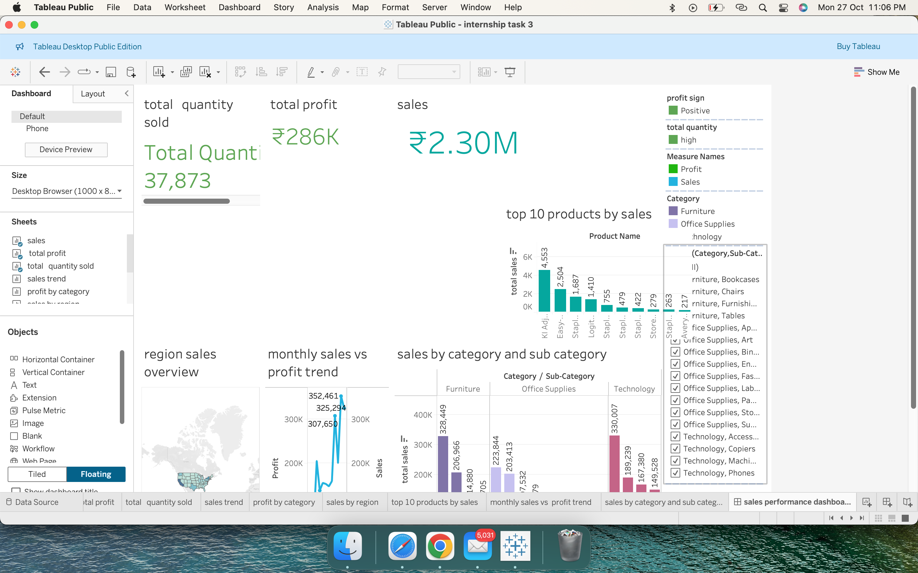
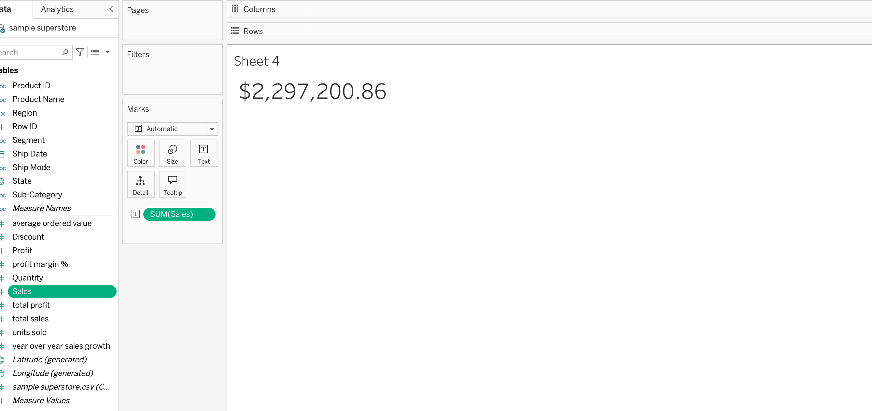
Some of the examples

